Slide 1
JAVA PROGRAMMING PROJECT | CO1–CO6
CINEMA SEAT_x000B_BOOKING SYSTEM
Choose a movie. Book your seats. Enjoy the show.
K. Veneela Keerthi — 2620030599
Rushmitha — 2620030570
CSPG • JAVA PROJECT PRESENTATION

Slide 2
PROJECT OVERVIEW
Abstract & Problem Statement
• A Java console application for selecting movies, showtimes and cinema seats.
• Inputs: customer name, movie, showtime, seat numbers and ticket count.
• Processing: validate choices, check seat availability and calculate ticket cost.
• Outputs: booking details, total price, selected seats and booking status.
• Booking records can be saved in a text file for later viewing.
PROBLEM TO SOLVE
Manual seat booking can cause confusion and duplicate bookings. This program organises seat selection and helps prevent booking seats that are already taken.
CINEMA SEAT BOOKING • JAVA PROJECT
02

Slide 3
INPUT, DATA TYPES & OUTPUT
CO1 — Java Foundations
Scanner sc = new Scanner(System.in);_x000B__x000B_System.out.print("Enter movie name: ");_x000B_String movie = sc.nextLine();_x000B_System.out.print("Enter number of seats: ");_x000B_int seats = sc.nextInt();_x000B_double price = 180.0;_x000B_System.out.printf("Total: ₹%.2f%n", seats * price);
ONLY THE KEY POINTS
• Scanner reads the customer’s choices.
• String stores movie and customer names.
• int stores seat numbers and ticket counts.
• double stores ticket prices; printf formats the total.
CINEMA SEAT BOOKING • JAVA PROJECT
03

Slide 4
SELECTION & ITERATION
CO2 — Conditions & Loops
if (seatAvailable) {_x000B_ seats[seatNumber] = true;_x000B_ System.out.println("Seat booked");_x000B_} else {_x000B_ System.out.println("Seat unavailable");_x000B_}_x000B__x000B_for (int i = 0; i < ticketCount; i++) {_x000B_ // select each seat_x000B_}
ONLY THE KEY POINTS
• if-else checks whether a seat is available.
• for loops allow customers to select multiple seats.
• while can repeat until a valid seat is entered.
• Conditions prevent invalid or duplicate bookings.
CINEMA SEAT BOOKING • JAVA PROJECT
04

Slide 5
REUSABLE CALCULATIONS
CO3 — Methods & Arrays
static double calculateTotal(int[] seats,_x000B_ double price) {_x000B_ return seats.length * price;_x000B_}_x000B__x000B_static boolean isSeatValid(int seat,_x000B_ boolean[] booked) {_x000B_ return seat >= 0 && seat < booked.length_x000B_ && !booked[seat];_x000B_}
ONLY THE KEY POINTS
• Arrays store seat availability for a show.
• Methods calculate ticket totals and validate seats.
• Reusable methods keep the program organised.
• Array indexes help identify individual seats.
CINEMA SEAT BOOKING • JAVA PROJECT
05

Slide 6
OBJECT-ORIENTED PROGRAMMING
CO4 — Classes, Objects & Exceptions
static class Booking {_x000B_ private String customerName;_x000B_ private String movieName;_x000B_ private int seatNumber;_x000B__x000B_ Booking(String customerName,_x000B_ String movieName, int seatNumber) {_x000B_ this.customerName = customerName;_x000B_ this.movieName = movieName;_x000B_ this.seatNumber = seatNumber;_x000B_ }_x000B_}
ONLY THE KEY POINTS
• Booking is a blueprint for one reservation.
• The constructor initialises each booking object.
• private fields demonstrate encapsulation.
• try-catch can handle invalid booking input.
CINEMA SEAT BOOKING • JAVA PROJECT
06

Slide 7
BOOKING RECORDS & FILE I/O
CO5 — Strings & File Handling
String line = customerName + ","_x000B_ + movieName + ","_x000B_ + seatNumber;_x000B_lines.add(line);_x000B__x000B_Files.write(Path.of("bookings.txt"), lines);_x000B__x000B_List<String> saved =_x000B_ Files.readAllLines(Path.of("bookings.txt"));
ONLY THE KEY POINTS
• Strings combine customer, movie and seat details.
• Files.write saves records in bookings.txt.
• Files.readAllLines loads previous bookings.
• split(",") separates fields when reading records.
CINEMA SEAT BOOKING • JAVA PROJECT
07

Slide 8
SHOW & SEAT MANAGEMENT
CO6 — Collections & Streams
Map<String, Long> movieBookings =_x000B_ bookings.stream()_x000B_ .collect(Collectors.groupingBy(_x000B_ Booking::getMovieName,_x000B_ Collectors.counting()));_x000B__x000B_movieBookings.forEach((movie, count) ->_x000B_ System.out.printf("%-15s : %d bookings%n",_x000B_ movie, count));
ONLY THE KEY POINTS
• ArrayList can store all Booking objects.
• Map stores movie names and booking counts.
• Streams process booking records neatly.
• groupingBy and counting create a simple report.
CINEMA SEAT BOOKING • JAVA PROJECT
08

Slide 9
SAMPLE BOOKING RECEIPT
Sample Output & Seat Availability
========== BOOKING RECEIPT ==========_x000B_Customer : Lasya_x000B_Movie : Example Movie_x000B_Showtime : 6:30 PM_x000B_Seats : A4, A5_x000B_Tickets : 2_x000B_Price per seat: ₹180.00_x000B_Total Amount : ₹360.00_x000B_Booking Status: CONFIRMED_x000B__x000B_--- SEAT STATUS ---_x000B_A1 A2 A3 [A4] [A5] A6 A7
KEY RESULTS
• The receipt shows movie and showtime details.
• Selected seats are listed clearly.
• The ticket total is calculated automatically.
• Sample details are illustrative, not live bookings.
CINEMA SEAT BOOKING • JAVA PROJECT
09

Slide 10
HOW IT WORKS
Workflow & Testing
• 1. Enter customer name, movie and showtime.
• 2. Display the seats available for that show.
• 3. Choose seat numbers and validate availability.
• 4. Calculate the total ticket price and confirm booking.
• 5. Save the booking and display the receipt.
TEST CASES
• Available seat selected: booking confirmed_x000B__x000B_• Already-booked seat: booking rejected_x000B__x000B_• Invalid seat number: user asked to try again_x000B__x000B_• Missing booking file: friendly message displayed
CINEMA SEAT BOOKING • JAVA PROJECT
10

Slide 11
PROJECT OUTCOME
Conclusion
• The project makes cinema seat booking simple and organised.
• It applies Java concepts from CO1 to CO6 in one practical application.
• Methods and arrays support seat selection and ticket calculations.
• Classes model bookings, while file handling saves reservation details.
• Future improvements may include online payments and a graphical seat map.
KEY BENEFIT
A simple way to select seats, avoid duplicate reservations and receive a clear booking summary.
CINEMA SEAT BOOKING • JAVA PROJECT
11

Slide 12
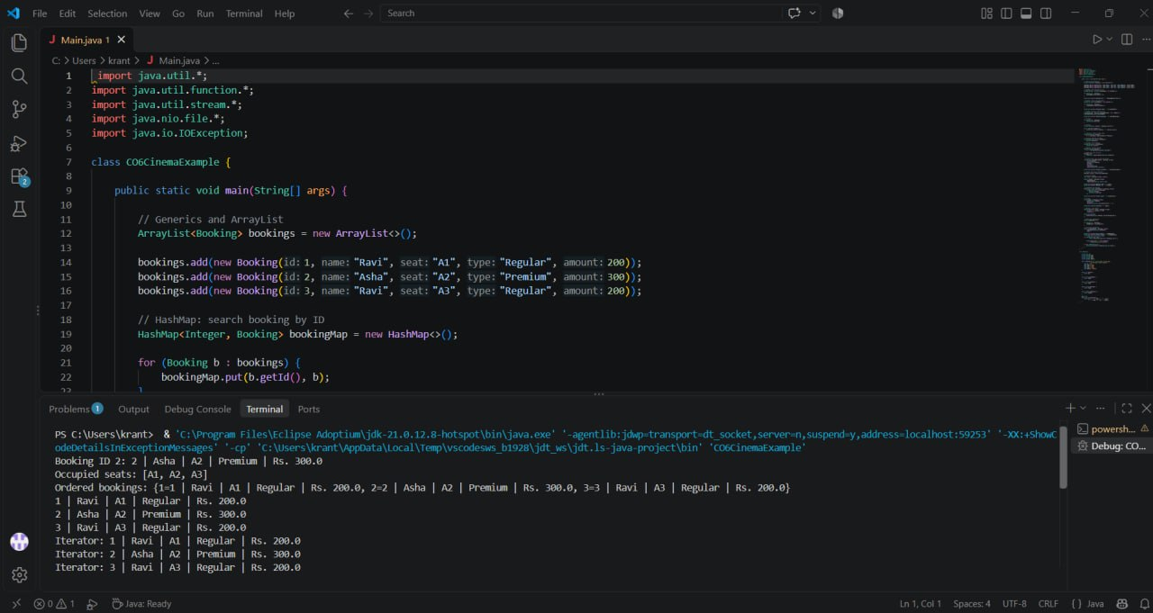

Slide 13
GITHUB URL
CINEMA SEAT BOOKING • JAVA PROJECT
12

Slide 14
THANK YOU!
Questions & feedback are welcome.
K. Veneela Keerthi — 2620030599
Rushmitha — 2620030570
CINEMA SEAT BOOKING • JAVA

